Slide 1
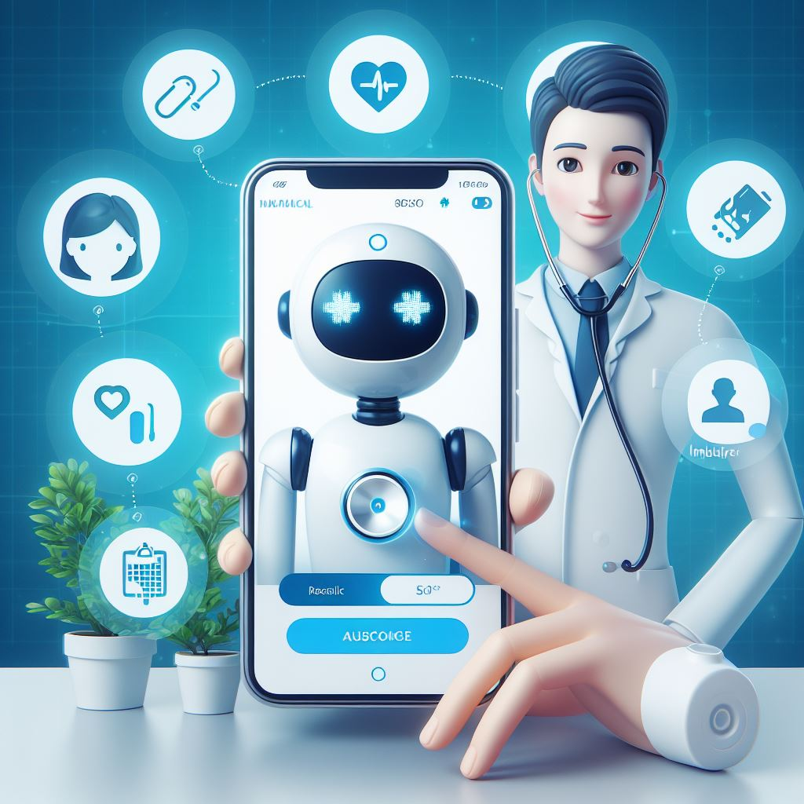

Scientific Computing Department Faculty of Computer and information Sciences Ain shams University
Diagnosing diseases using deep learning techniques

Slide 2

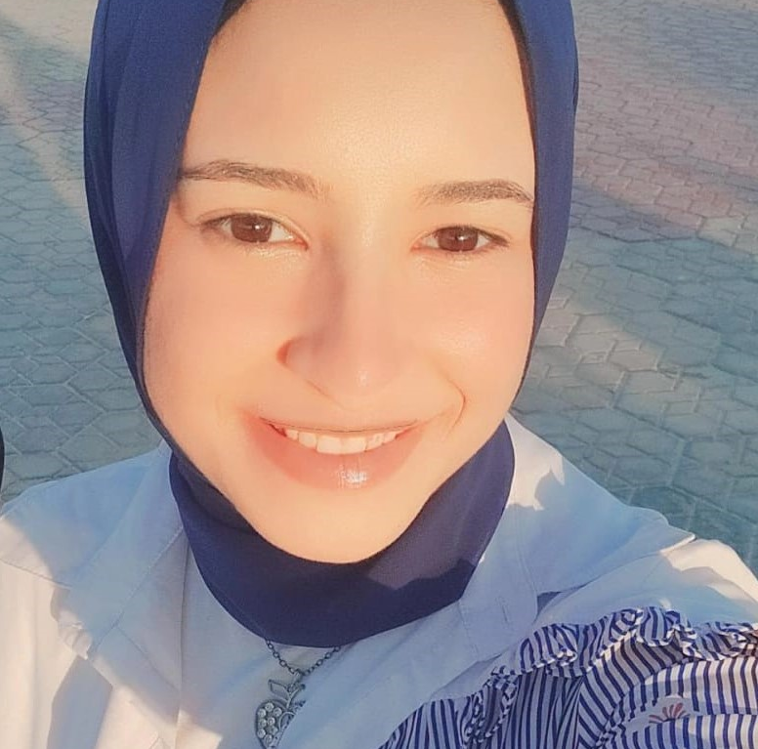
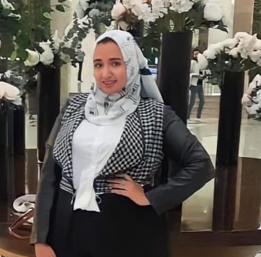
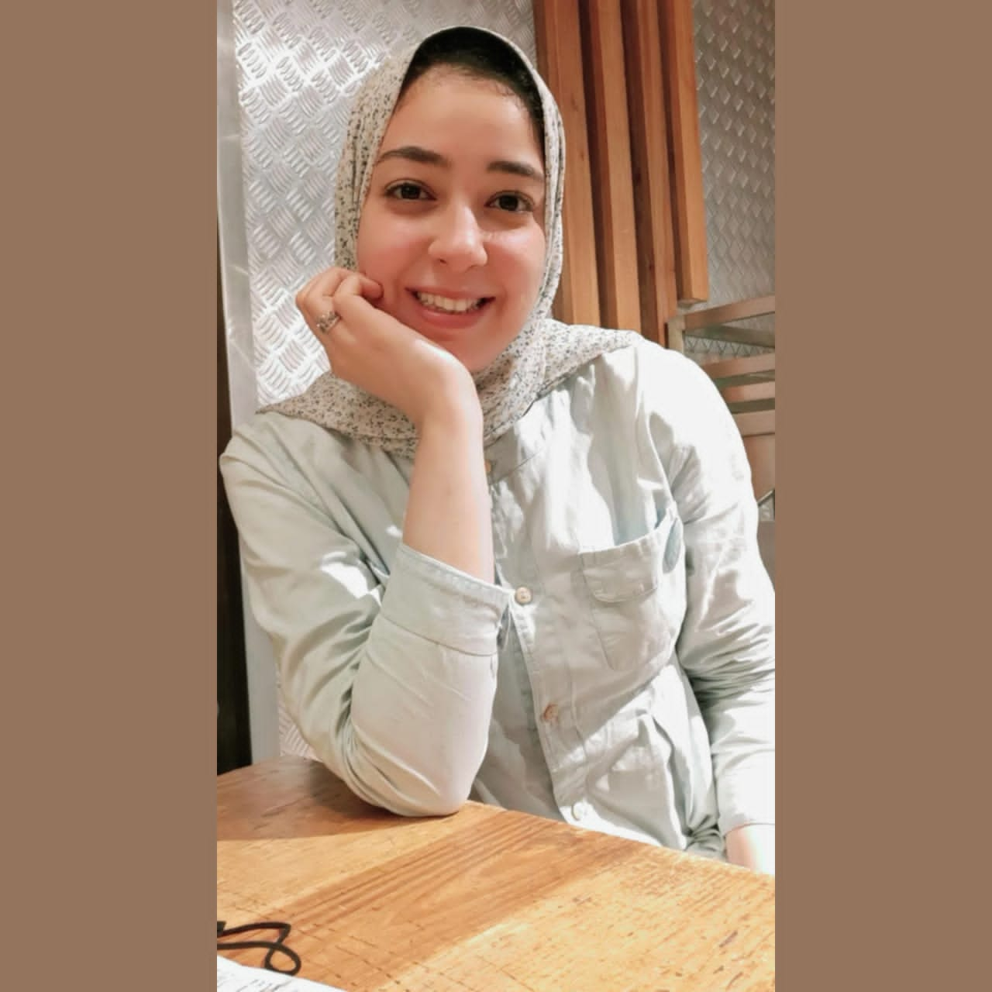
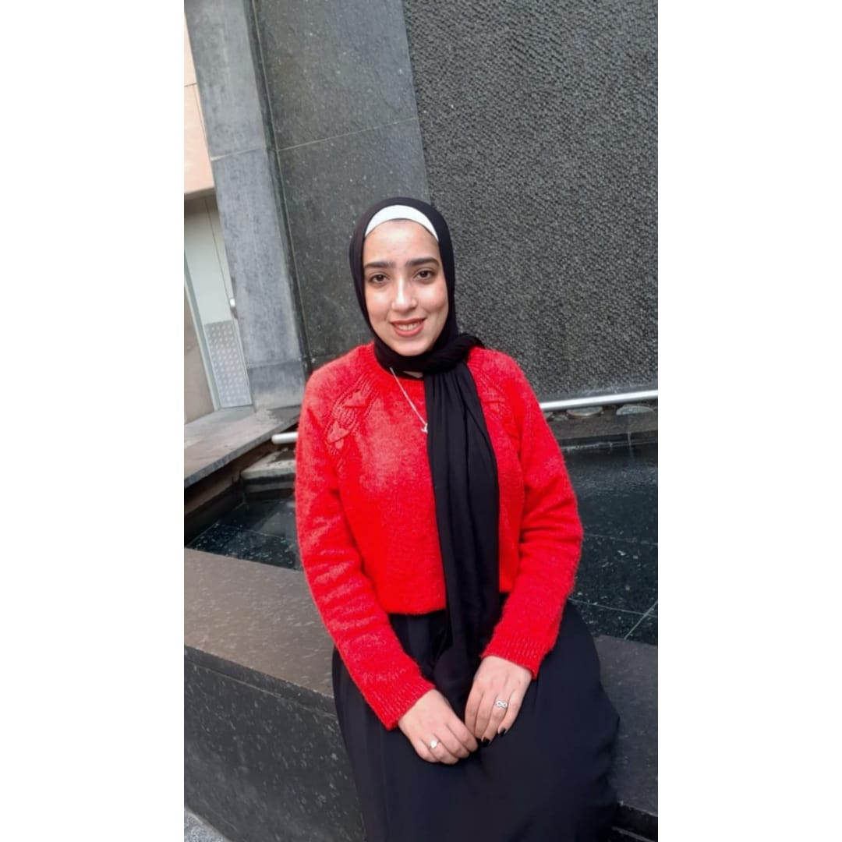
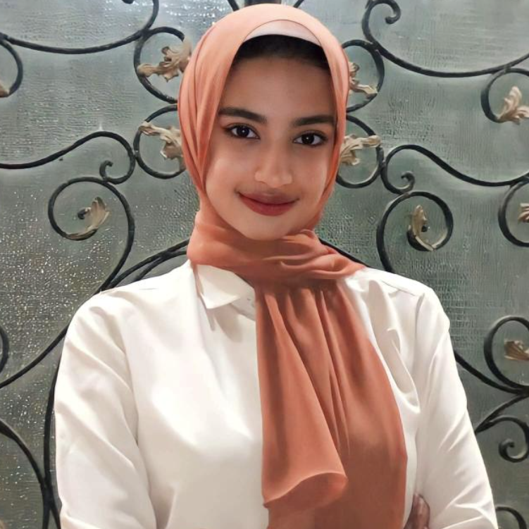
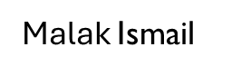
TEAM Members
Fady Makram
Manar Ibrahim
Manar Mohamed
Manar Alaa
Menna Ibrahim
Under Supervision
Dr. Dina El-Sayad
TA. Heba Gamal Ahmed

Slide 3

Agenda
Problem Definition
Motivation
Objectives
Benefits
Related Work
System Architecture
Datasets
Preprocessing
Methodology
Challenge
Experimental Results
Conclusions
Future Work

Slide 4
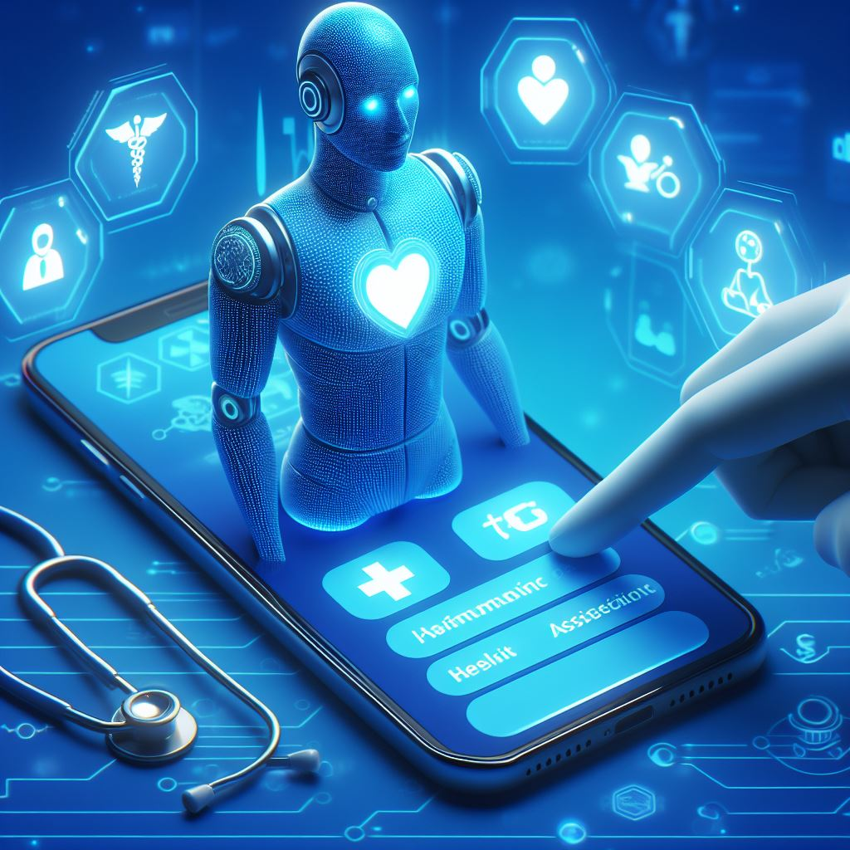
Problem Definition

Slide 5
Problem Definition
There are people whose conditions may be misdiagnosed situations.
There are places where healthcare and facilities do not have infection control measures.

Slide 6

Problem Definition Cont.
In 2019, the Corona pandemic appeared and led to a lack of interaction between Humans face to face.

Slide 7
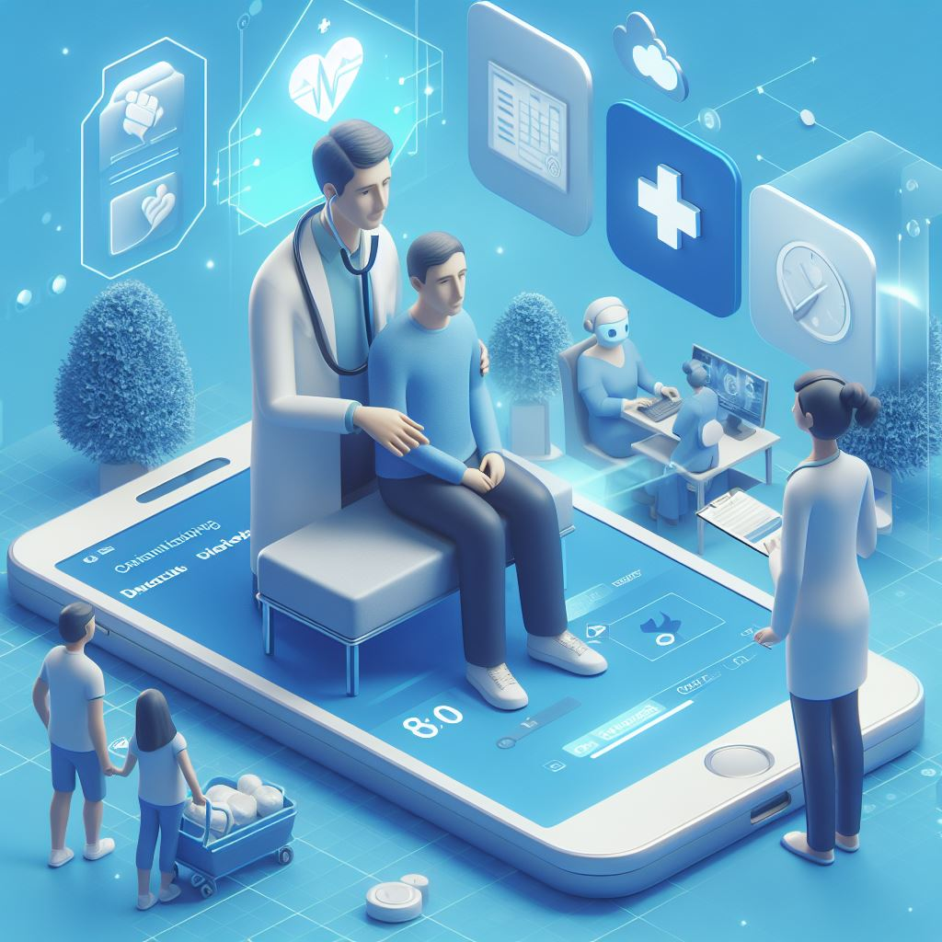
Motivation

Slide 8
Motivation
Helping patients and people who live in places where health care is not available.
people who find it difficult to move due to illness.
In addition to reducing contact between people.

Slide 9
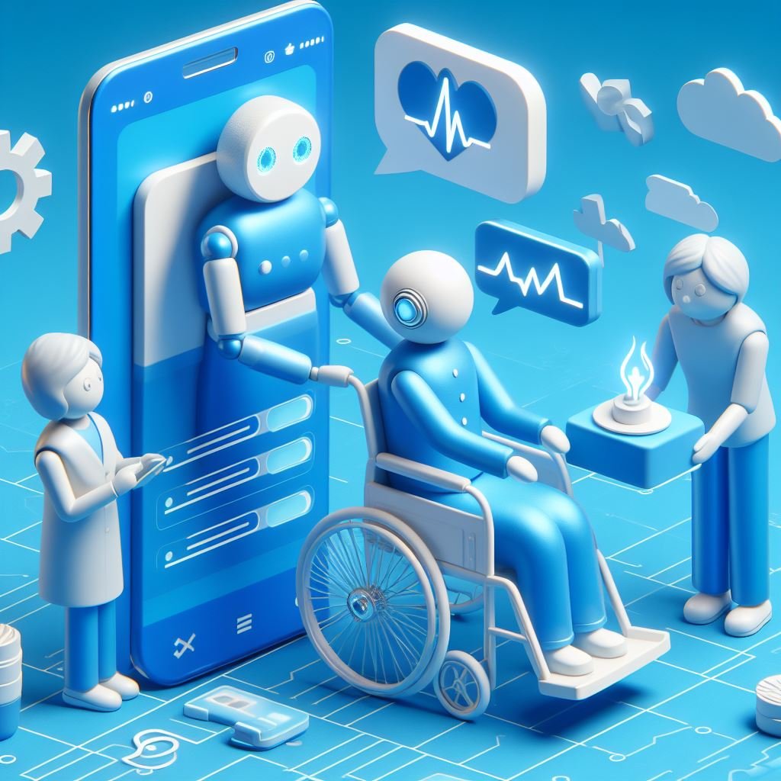
Objectives

Slide 10
Objectives
Software App
Medical Chatbot
Using Deep Learning Models
Build an application to provide medical assistance and facilitate the process of obtaining correct medical information about diseases and how to avoid them by using deep learning techniques.

Slide 11
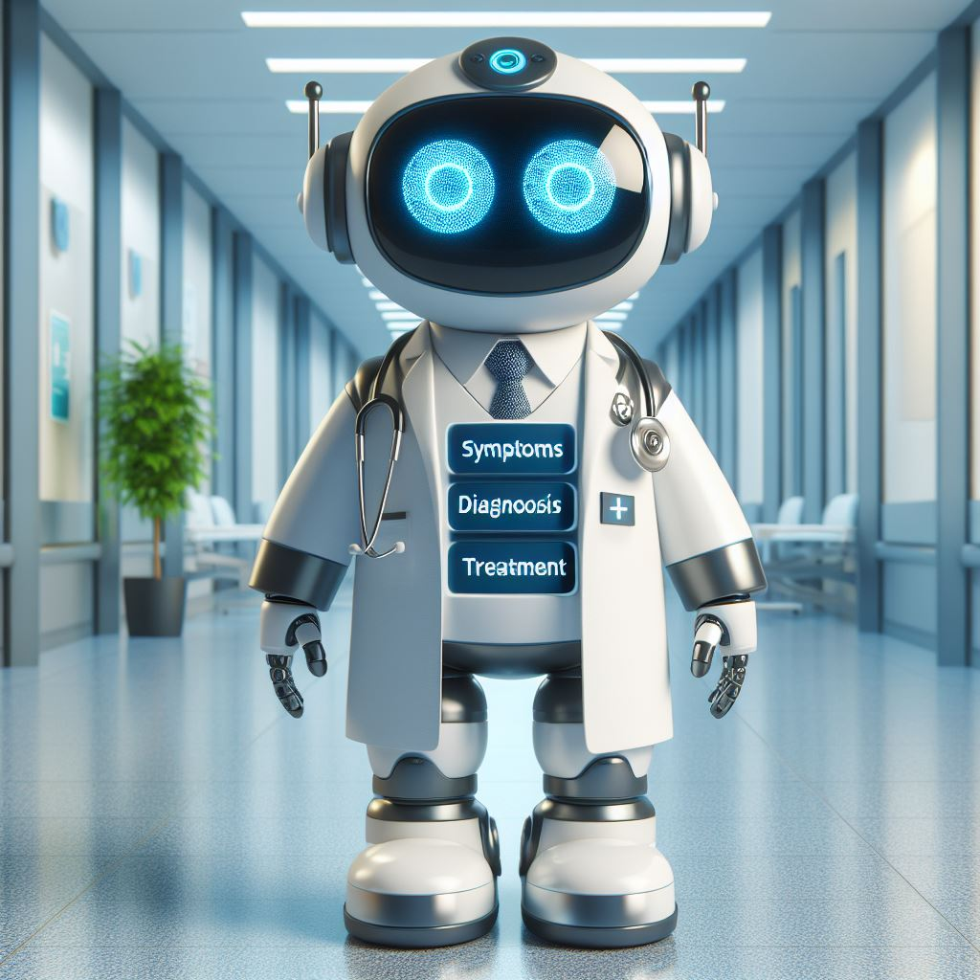
Benefits

Slide 12
Benefits
providing Junior doctors with experience.
Saving time and effort of Professional doctors.
Providing the users with healthcare facilities.

Slide 13
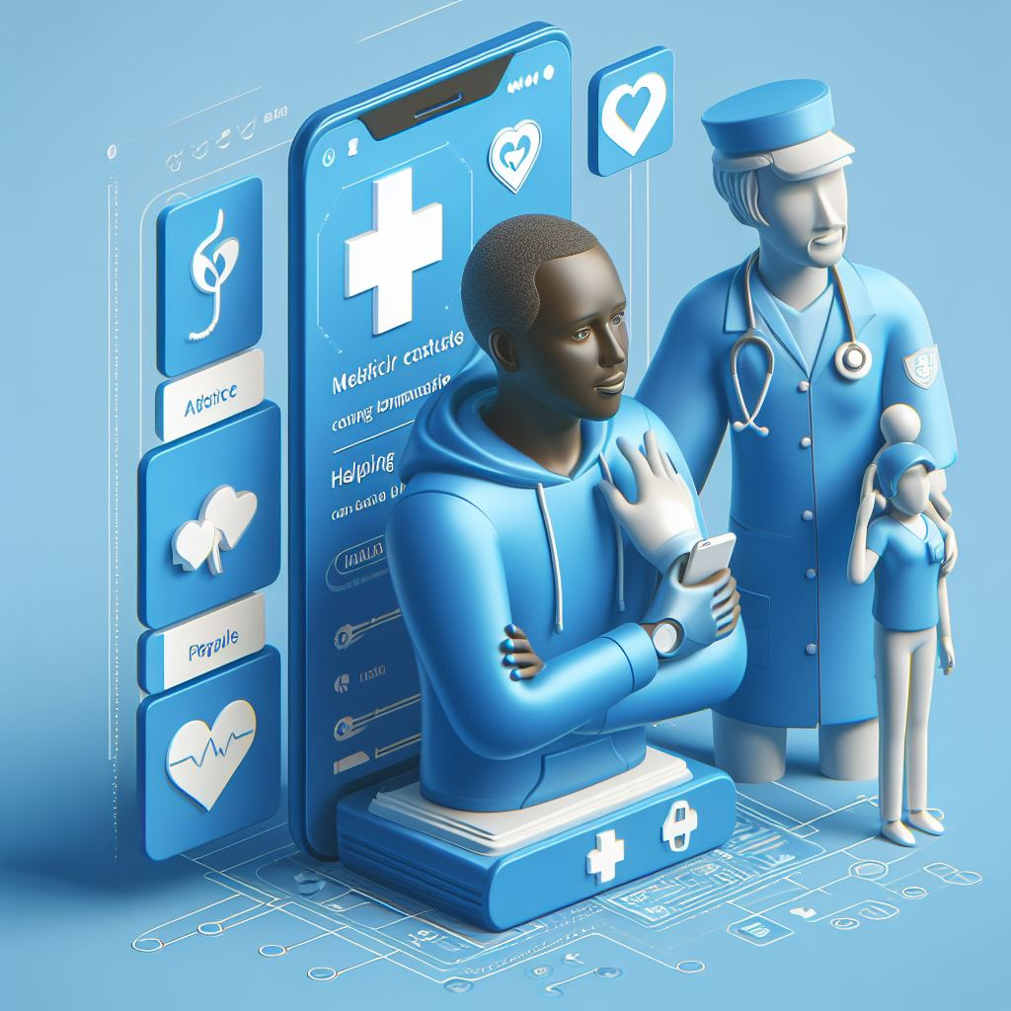
Related Work

Slide 14
Paper | Dataset | Models | Measurements
Deep learning for Arabic healthcare: MedicalBot [1] [2023] | MAQA Size = 434544 records | LSTM Bi-LSTM Transformers Model | Cos Similarity :56% Bleu :31% Cos Similarity :72% Bleu :39% Cos Similarity :80% Bleu: 58%
DZchatbot: A Medical Assistant Chatbot in the Algerian Arabic Dialect using Seq2Seq Model[2] [2022]. | DZMedicaldata, Size = 2150 records | LSTM, GRU Bi-LSTM | Accuracy: 78%. Accuracy: 71%.
HHH: An Online Medical Chatbot System based on Knowledge Graph and Hierarchical Bi-Directional Attention[3] [2020] | Collected Data from medical websites Size = 29287 records | BERT MaLSTM HBAM | Accuracy: 78.2%. Accuracy: 78.4%. Accuracy: 81.2%.
Personalized Healthcare Chatbot: Dataset and Prototype System[4] [2022] | Collected Data from medical websites Size = 189 records | Rasa Architecture | Accuracy: 78.7%.

Slide 15
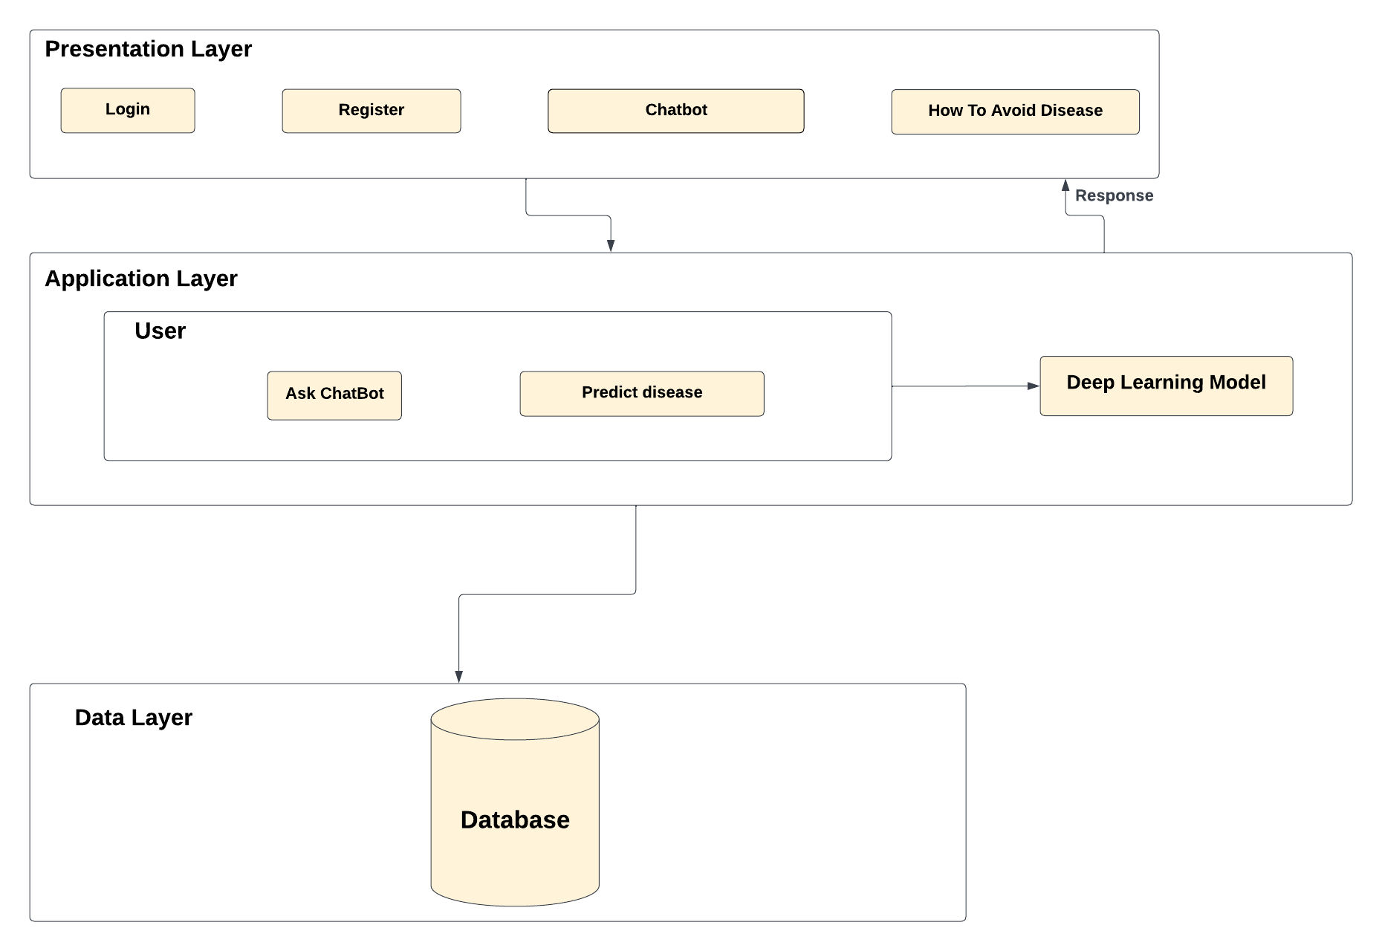
System Architecture

Slide 16
Datasets
Chatbot Datasets
Diagnosis Dataset

Slide 17
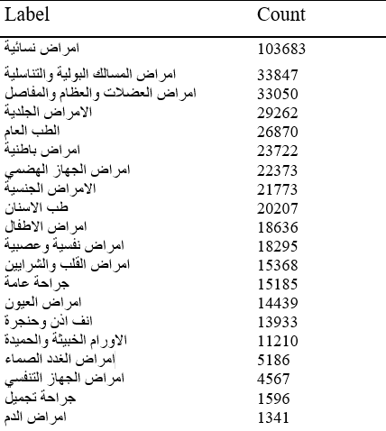
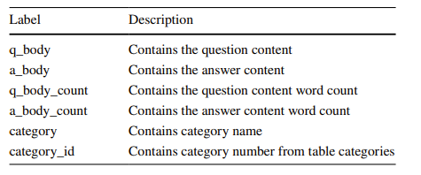
Datasets
Datasets
Chatbot First Dataset
Chatbot First Dataset
Healthcare Q &A dataset (MAQA) collected from various websites.
The dataset consists of more than 430k questions distributed into 20 medical specializations
Healthcare Q &A dataset (MAQA) collected from various websites.
The dataset consists of more than 430k questions distributed into 20 medical specializations
Command | Number | Appear
Max number of token per Q | 100 | 2
Max number of token per A | 30 | 1
Min number of token per Q | 1 | 5
Min number of token per A | 1 | 63
Mode number of token per Q | 30 | 18293
Mode number of token per A | 9 | 6812
Mean number of tokens per Q | 19 | 4496
Mean number of token per A | 17 | 4750
We used the entire data of 20 categories to initiate chatbot unbalanced dataset.
We used the entire data of 20 categories to initiate chatbot unbalanced dataset.
Question | Answer | q_body_count | a_body_count | category | category_id
حشو السن عصب ولكن اشعر بالم عند للاكل | ان الشعور بالم عند تناول الطعام بعد اجراء معالجه لبيع للسن يحتاج لاجراء صوره اشعه لكي توضح نتيجه الاجراء وننصه بالعوده الي الطبيب المعالج | 8 | 24 | طب الاسنان | 20
Question | Answer | q_body_count | a_body_count | category | category_id
حشو السن عصب ولكن اشعر بالم عند للاكل | ان الشعور بالم عند تناول الطعام بعد اجراء معالجه لبيع للسن يحتاج لاجراء صوره اشعه لكي توضح نتيجه الاجراء وننصه بالعوده الي الطبيب المعالج | 8 | 24 | طب الاسنان | 20

Slide 18
Datasets
Chatbot Second Dataset
We have scraped different number of record of each category to initiate chatbot balanced dataset which contains 8500 record of each category
We scraped dataset from altibbi website.
The dataset consists of 170.000 questions distributed into 20 medical specializations
Collected a questions since January 1, 2023 until January 1, 2024.
Question | Answer | q_body_count | a_body_count | category
اعاني من حكة دائمة في العينين ولما أجري اختبار الحساسية النتيجة لا توجد حساسية وهده الحالة أتخلص منها في فصل الشتاء فقط وعندي التهاب في الأنف أيضا لا حكة ولا... | طالما هناك حكة في العين فهذه تسمى حساسية وغالبا لا نعرف سبب التحسس لذلك الاختبارات لا تساعد في اغلب الأحيان بشيء | 30 | 21 | امراض العيون

Slide 19
Datasets
Diagnose Dataset
Disease symptom prediction dataset helps to create a disease prediction or healthcare system.
The dataset containing diseases, their symptoms , precautions to be taken, and their weights.
The dataset distributed into 41 disease and 17 symptom
We use different files from diagnose dataset
First file for disease prediction classifier
Second file for disease description retrieve
Third file for disease precaution
Symptom | Disease | Description | precaution
الم المفاصل وجع البطن فقدان الشهية القىْ | إلتهاب الكبد أ | التهاب الكبد (أ) هو عدوى الكبد شديدة العدوى الناجمة عن فيروس التهاب الكبد (أ). يعد الفيروس واحدًا من عدة أنواع من فيروسات التهاب الكبد التي تسبب الالتهاب وتؤثر على قدرة الكبد على أداء وظائفه. | استشارة أقرب مستشفى غسل اليدين تجنب الأطعمة الغنية بالتوابل الدهنية

Slide 20
Preprocessing
Chatbot preprocessing
Diagnosis preprocessing

Slide 21
Chatbot Preprocessing
1. First phase
Dropping
duplicates in data
Data balancing using augmentation
Translation-based technique
Scraping Technique
scrap data from altibbi.com website for small classes
Insertion using pretrained model “BERT”
Substitution using pretrained model “BERT”
Swapping two words
Back translation using pretrained model

Slide 22
2. Classification preprocessing
Dropping unnecessary columns
Tokenization of questions
Apply padding for tokenized questions
Label encoding for categories

Slide 23
3. Generation preprocessing
Removing advertisements or inappropriate links
Removing elongation (unnecessary repeated characters)
Replacing numbers with words
Detection of English words and removing them
Drop Questions with nan answers
Removing any extra white spaces
Standardizing letters forms of the Arabic words
Removing any diacritics

Slide 24
Diagnosis Preprocessing
Translate data from English to Arabic by using google translate
Replace _ with space
Fill nan by 0
Replace symptom with its weight

Slide 25
Methodology
Chatbot Models
Diagnosis Models

Slide 26
Chatbot Models
Pre-Classification
Machine Learning
Deep learning
Text Generation
Lstm
Bilstm
Transformer
Fine Tuning

Slide 27
Pre-Classification models
Machine learning models
Deep learning models
aubmindlab/bert-base-arabertv2 model
Transformer Model with GRU
Random forest
SVM
Soft Voting classifier
Lstm model

Slide 28
Text Generation

Slide 29
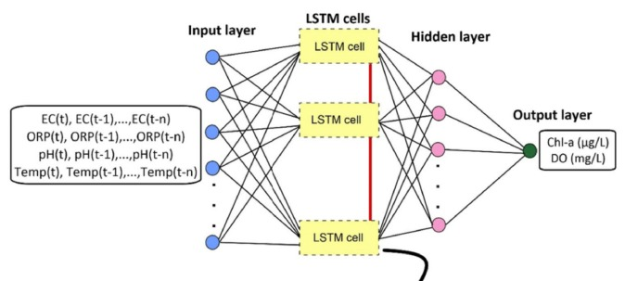
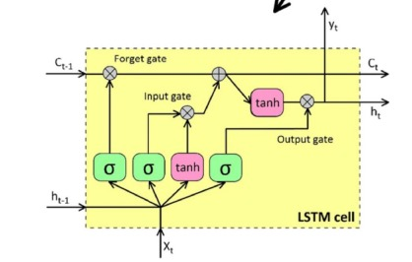
LSTM
Type of recurrent neural network
Capturing context
Handling sequential data
Generating coherent responses

Slide 30
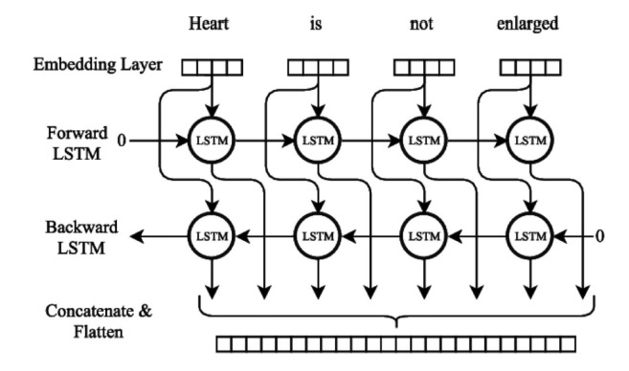
BiLSTM
Extension of the LSTM architecture
Incorporates information from both past and future contexts
Capture contextual information from both directions

Slide 31
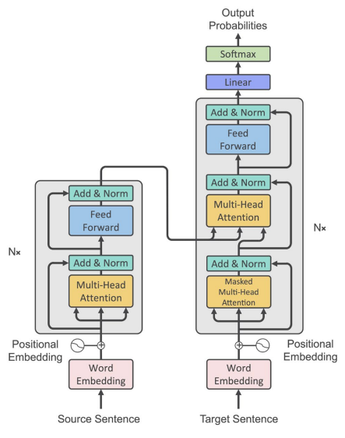
Transformer
Long-range dependencies
More efficient than traditional recurrent neural networks
Parallelization
Scalability(to large dataset)
Attention mechanism
31

Slide 32
AraBART-summ
AraBART is text summarization which available at Hugging face model hub
AraBART achieves the best performance on multiple abstractive summarization datasets, outperforming strong baselines including the following pretrained Arabic models :
BERTbased model
multilingual mBART
mT5 models
AraBART has 6 encoder and 6 decoder layers and 768 hidden dimensions
In total AraBART has 139M parameters and vocabulary size 50K tokens
Model trained on 10 Arabic dataset

Slide 33
Diagnosis Models
Machine learning models
SVM
Decision Tree
Random Forest
Soft Voting

Slide 34
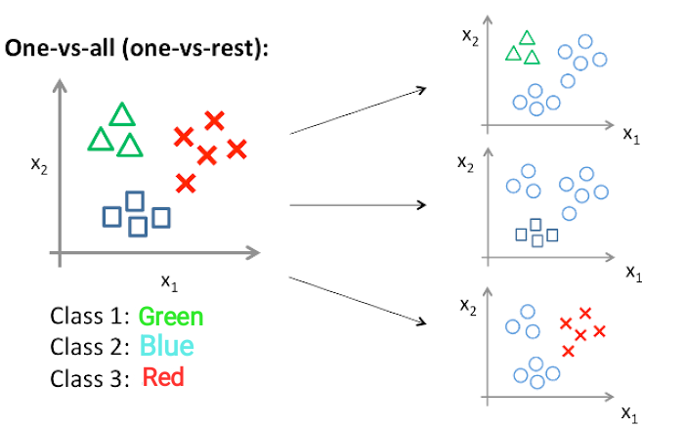

SVM
Support Vector Machine (SVM) can efficiently classify different denominations due to its ability to learn complex patterns and discriminate between classes effectively.
34

Slide 35
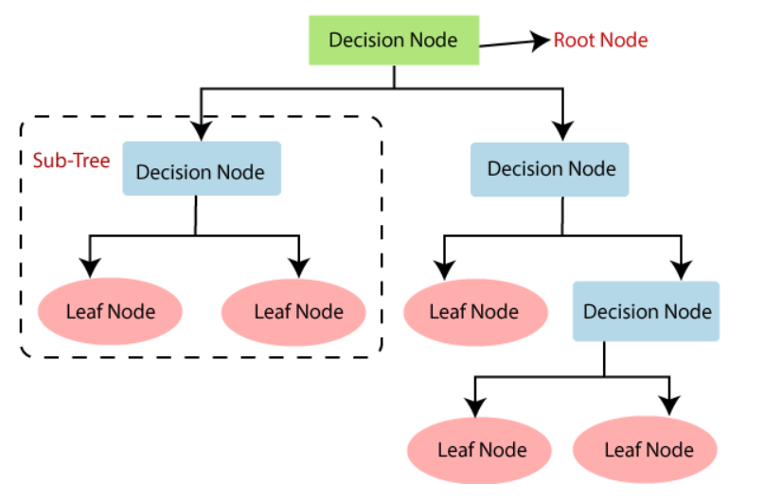
Decision Tree
Decision Tree is a simple, yet powerful algorithm used in recognition tasks . It partitions data based on features to create a tree-like structure.
35

Slide 36
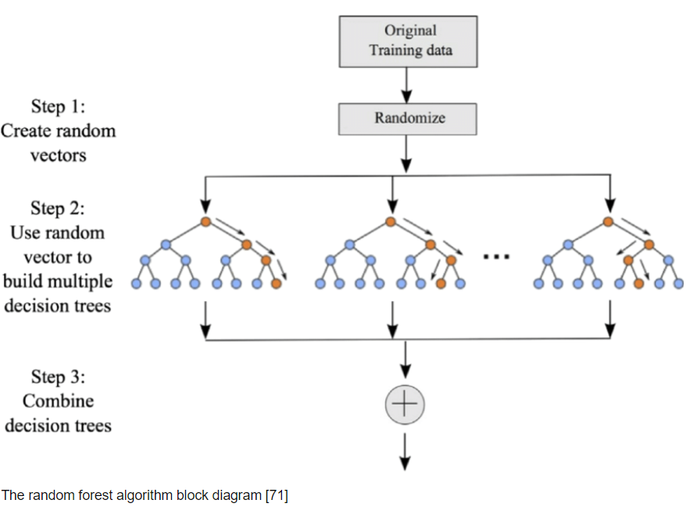
Random Forest
Random Forest is used in recognition tasks for its ability to handle high-dimensional data and complex relationships between features
36

Slide 37
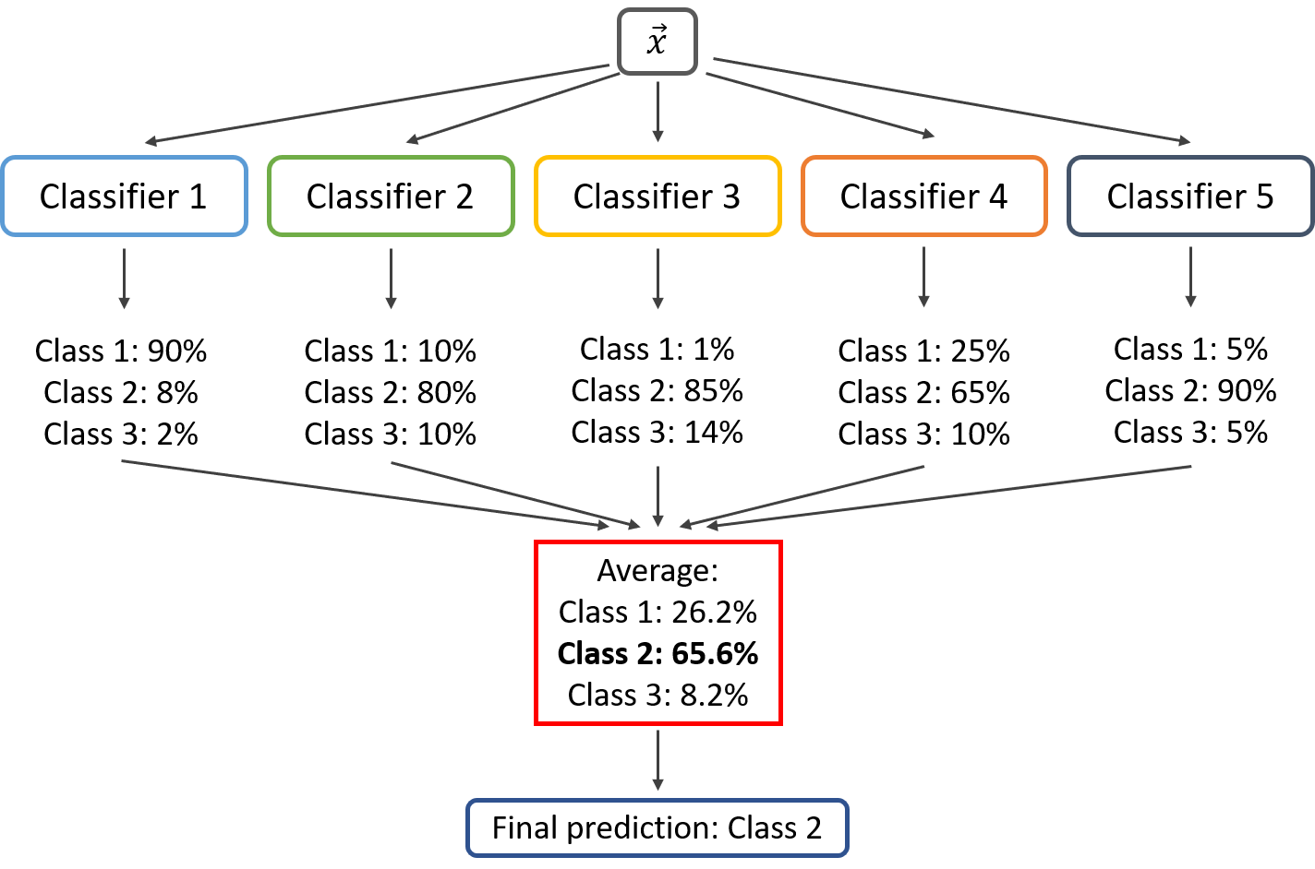
Soft Voting
Each model outputs probabilities for each class, and the final prediction is based on the average of these probabilities.
37

Slide 38
Experimental Results
Diagnosis
Chatbot

Slide 39

Diagnosis Results

Slide 40
Best Result
Soft voting using models
(Random forest , Decision tree, SVM)
The Result of Diagnosis Classification

Slide 41
Chatbot Results
All Unbalanced Data
All Balanced Data
Combine pre-classification & Text Generation

Slide 42
MAQA Unbalanced Data
18 words as a maximum length

Slide 43
MAQA Data Balanced
For MAQA Data Balanced
We run Transformer and Fine Tuning.
We get maximum similarity 96.2 % and blue 63 %
Transformer and Fine Tuning.
Maximum similarity 96.2 % and blue 63 %
Experiment | Transformer | Fine Tuning
Balanced Data
Similarity :95.7 %
Similarity :96.2 %
Experiment | Transformer | Fine Tuning
Balanced Data
Bleu: 62 %
Bleu: 63 %
Experiment | Transformer | Fine Tuning
Balanced Data
Similarity :95.7 %
Similarity :96.2 %
Bleu: 62 %
Bleu: 63 %

Slide 44
Result of Pre-classification Models
Model | Hyperparameter | Best Result
Machine learning model | Vote soft voting | AUC:96 % Accuracy:71.6 % F1 Score:71.6 % Precision:71.4 % Recall:71.6%
Pretrained Deep learning model “aubmindlab/bert-base-arabertv2” | Batch size 32 Epochs 4 | AUC: 97% Accuracy: 73.6% F1 Score:73.6% Precision:73.5% Recall: 73.6%

Slide 45
Results of Balanced Data for Each Class

Slide 46
Balanced Data with Pre-classifier
Transformer and Fine Tuning.
Maximum similarity 96.6 % and blue 63 %
Experiment | Transformer | Fine Tuning
Balanced Data with Pre-classifier
Similarity :95.4 %
Similarity :96.6 %
Bleu: 61.5%
Bleu: 63 %

Slide 47
Model | Parameters | Matrix
Fine tuning Model With Pre-classifier | Epochs 50 Batch size 64 Warmup steps 100 weight decay 0.01 | Similarity:96.6% BLEU: 63%
Result of Generation Chatbot

Slide 48
Category (امراض الدم)
question: هل من الممكن ان تتسبب كبسولات زيت جنين القمح (اكسترا-1000 سيديكو)فى حدوث حساسية وهرش فى الجلد
answer: نعم محتمل أن تسببها لدى البعض
question: هل اللب الابيض الغير مملح يتسبب فى زيادة الوزن - وهل يتسبب فى الاصابة بداء السكرى - وهل يسبب حساسية
answer: لا لكن ممsكن أن يسبب حساسية لدى البعض وإن كان ذلك نادر الحدوث

Slide 49
Category (امراض الجهاز الهضمي)
predicted_category: امراض الجهاز الهضمي
real category: الامراض الجلدية
Q1: السلام عليكم ي دكتور انا اشعر بالم داخل فتحه سره البطن وايضا اشعر بانتفاخ بسيط بالبطن فوق السره وايضا تخرج رايحه كريهه من فتحه السره ماهو تشخيص هاذي الحاله

Slide 50
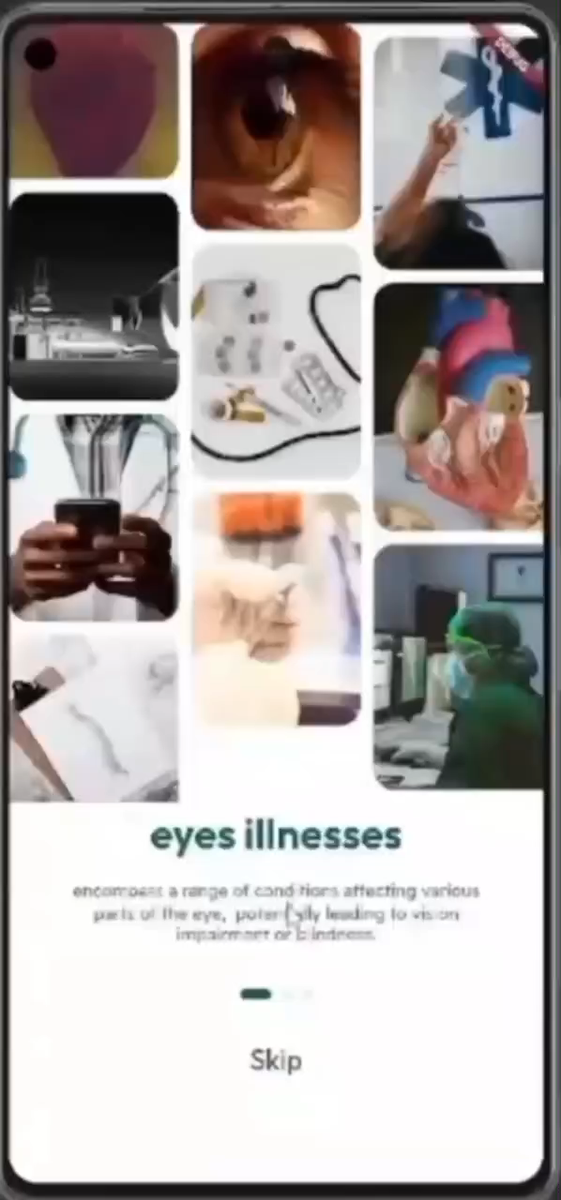
Demo

Slide 51
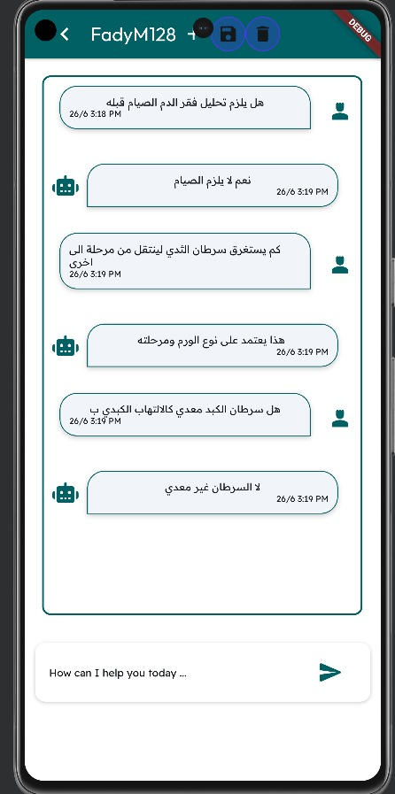
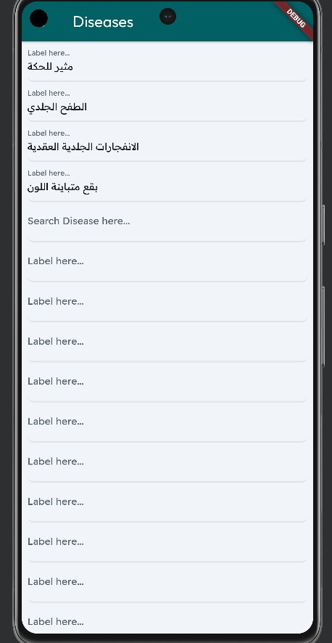
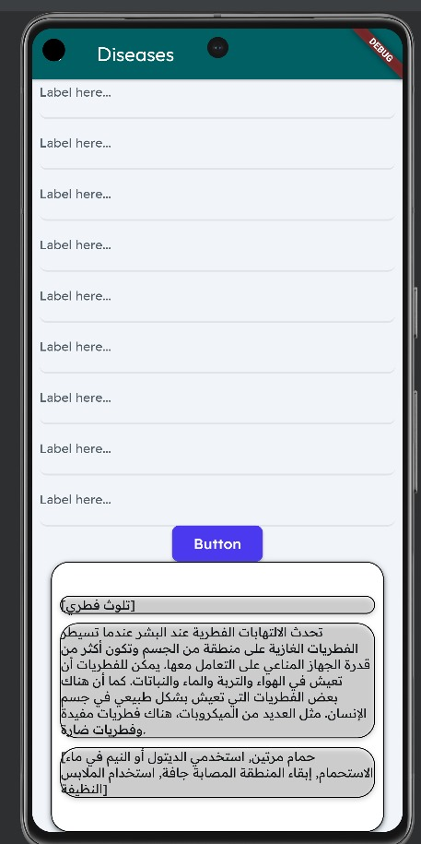

Slide 52


Conclusions
First, we can achieve our target by building chatbot.
Go through full description of used datasets for generation and classification
Implement three deep learning models and compare the performance.
Explain the effect of balancing data on the models and results.
Present the results of disease diagnosis classification model
Build a usable user graphical interface.
52

Slide 53
Future Work
Expand Dataset: Collect more diverse and comprehensive datasets to improve model accuracy and generalization.
Real-time Data Integration: Incorporate real-time data inputs from healthcare databases to keep the model up-to-date.
Multi-language Support: Implement models that can handle multiple languages to broaden accessibility.
Privacy and Security: Focus on enhancing data privacy and security measures to protect user information.
Multimodal Input: Incorporate voice, image, or video inputs for a more comprehensive diagnostic tool.
Accessibility Features: Ensure the chatbot is accessible to users with disabilities, enhancing inclusivity.

Slide 54
Abdelhay, Mohammed, Ammar Mohammed, and Hesham A. Hefny. "Deep learning for Arabic healthcare: MedicalBot." Social Network Analysis and Mining 13.1 (2023): 71.
Boulesnane, Abdennour, et al. "Dzchatbot: a medical assistant chatbot in the algerian arabic dialect using seq2seq model." 2022 4th international conference on pattern analysis and intelligent systems (PAIS). IEEE, 2022.
Bao, Qiming, Lin Ni, and Jiamou Liu. "HHH: an online medical chatbot system based on knowledge graph and hierarchical bi-directional attention." Proceedings of the Australasian computer science week multiconference. 2020.
Mishra, Prateek, et al. "Personalized Healthcare Chatbot: Dataset and Prototype System." International Conference on Computational Intelligence in Communications and Business Analytics. Cham: Springer International Publishing, 2022.
References

Slide 55
Boussakssou, Mohamed & Ezzikouri, Hanane & Erritali, Mohammed. (2022). Chatbot in Arabic language using seq to seq model. Multimedia Tools and Applications. 81. 1-13.
Mohammad, Abu Bakr & Eissa, Kareem & El-Beltagy, Samhaa. (2017). AraVec: A set of Arabic Word Embedding Models for use in Arabic NLP. Procedia Computer Science. 117. 256-265.
Zhou, Kaitlyn & Ethayarajh, Kawin & Card, Dallas & Jurafsky, Dan. (2022). Problems with Cosine as a Measure of Embedding Similarity for High Frequency Words.
Hendy, Amr & Abdelrehim, Mohamed & Sharaf, Amr & Raunak, Vikas & Gabr, Mohamed & Matsushita, Hitokazu & Kim, Young Jin & Afify, Mohamed & Awadalla, Hany. (2023). How Good Are GPT Models at Machine Translation? A Comprehensive Evaluation. 10.48550/arXiv.2302.09210.
References

Slide 56

Any
Questions

Slide 57

Thank You

